Slide 1
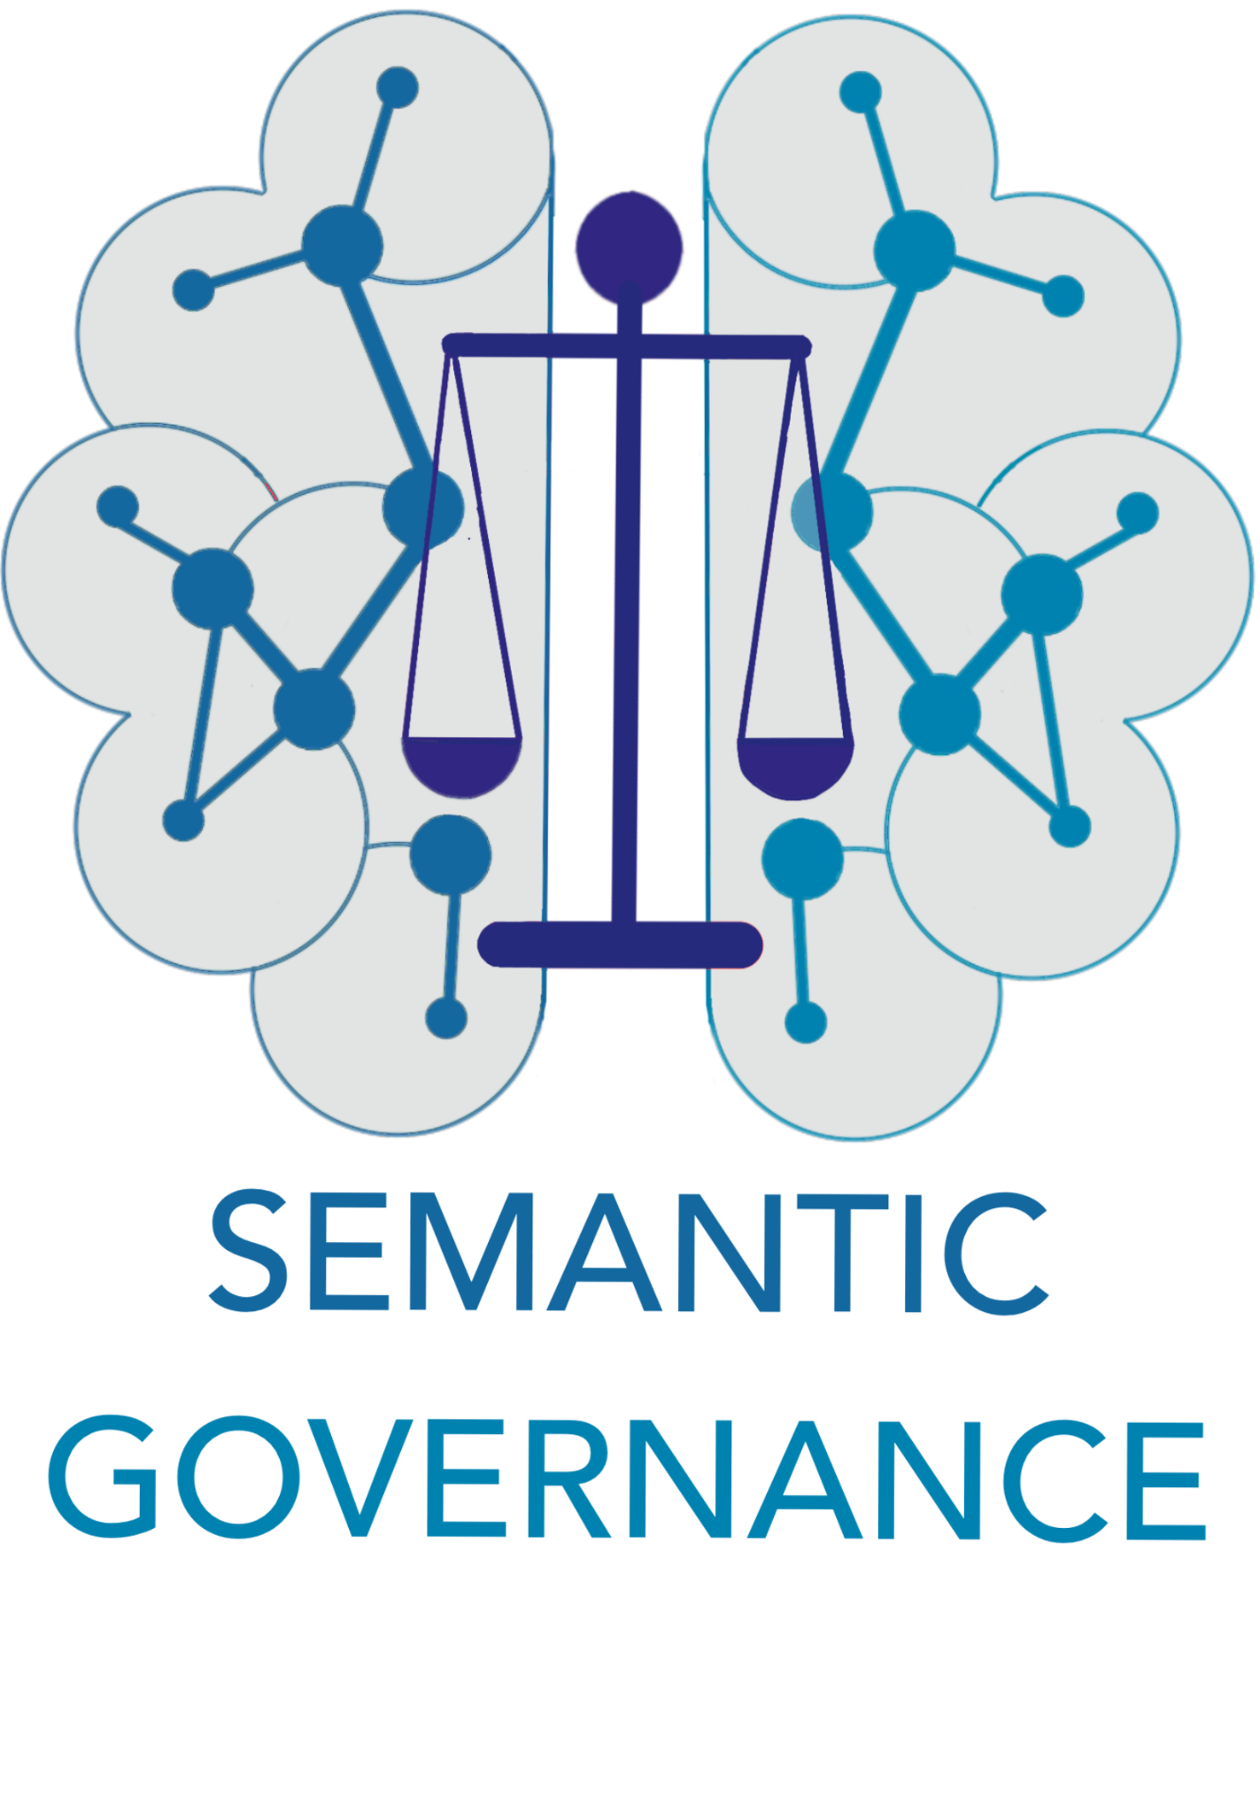
INCOSE KSWG
Semantic Governance
Jeffrey Wallk
Sherri Anderson
INCOSE October 30, 2025

Slide 2

Semantic Governance:Overview
Semantic Governance is built upon standards (ISO) and best practices for Knowledge Engineering to create and maintain the core knowledge (vocabularies, taxonomies, and ontologies) shared across the organization and the domain-specific knowledge (vocabularies, taxonomies, and ontologies unique to each domain and sub-domain)
These knowledge artifacts are built and maintained in our Semantic Knowledge Layer using the Semantic Services (see slide 14) and governed with our Operating Model to ensure controls are in place covering all phases of the Knowledge Engineering Lifecycle including publishing and downstream consumption of enterprise and domain-specific knowledge.

Slide 3
Semantic Governance: What
WHAT:
Semantic Governance helps users access data using familiar terms (not necessarily those in the glossary of terms in a catalog or perhaps an enterprise dictionary). Semantics are associated with a point of view (POV) for a persona and/or a point in context (scenario). But, it's more than just simple mapping of terms. It extends to phrases that can be interpreted and mapped to complex data. The semantic layer provides contextual relevance for our analytics so we can harmonize points of view into a holistic and consistent understanding.
HOW:
In order to achieve a consistent meaning of content it must be informed by context that is relevant (mapped to terms that are familiar to Personas) across the organization. Requires a disciplined effort to curate both the semantics and their mappings to our structured vocabularies and ontologies.

Slide 4
Semantic Governance: Why
What can it do for me?
Aggregates, integrates, and organizes data and information to create a unified view, making it easily accessible for decision-makers by providing relevant insights and context at the right time.
Provides a structured way to represent information to model relationships, context, and hierarchies to enhance learning, curate context, and connect structured and unstructured data to help AI understand and interpret data and information to deliver meaningful insights.
Supports continuous learning for AI so it can adapt as new data, context, and information become available and improves insight delivery by enhancing transparency and explainability.

Slide 5
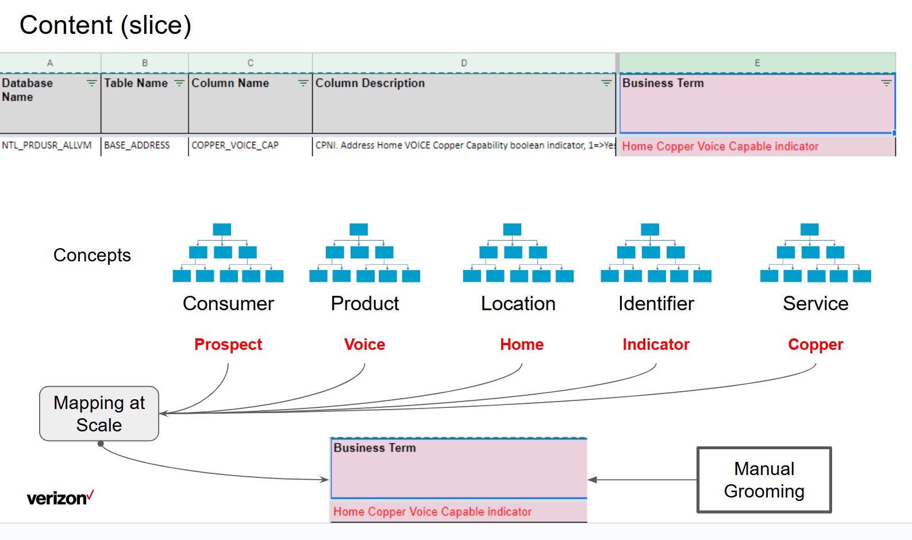
Semantic Governance: Why (Example)
Beyond Cataloging...
Key challenge is addressing polymorphic meaning of “things”.
Conventional attribution fails and AI is needs to be tuned to perform this at scale.
Example

Slide 6
Semantic Governance: Impact
Key Outcomes:
Consistent | Connected | Clear understanding about what changed, why things changed, and who might be impacted. Ensure our Data is FAIR (see Fairification) and Consumable (search & understand).
We could leverage the semantic layer to reduce ambiguity with different reports about the same topic (for example: Customer Churn could generate multiple reports showing various perspectives, where each is correct but only result in confusion until they are contextually harmonized so we can clarify meaning across a complex set of factors. )
Goal:
Deliver adaptable services, processes, systems, analytics, UX, and CX and accelerate decision making across the organization.

Slide 7
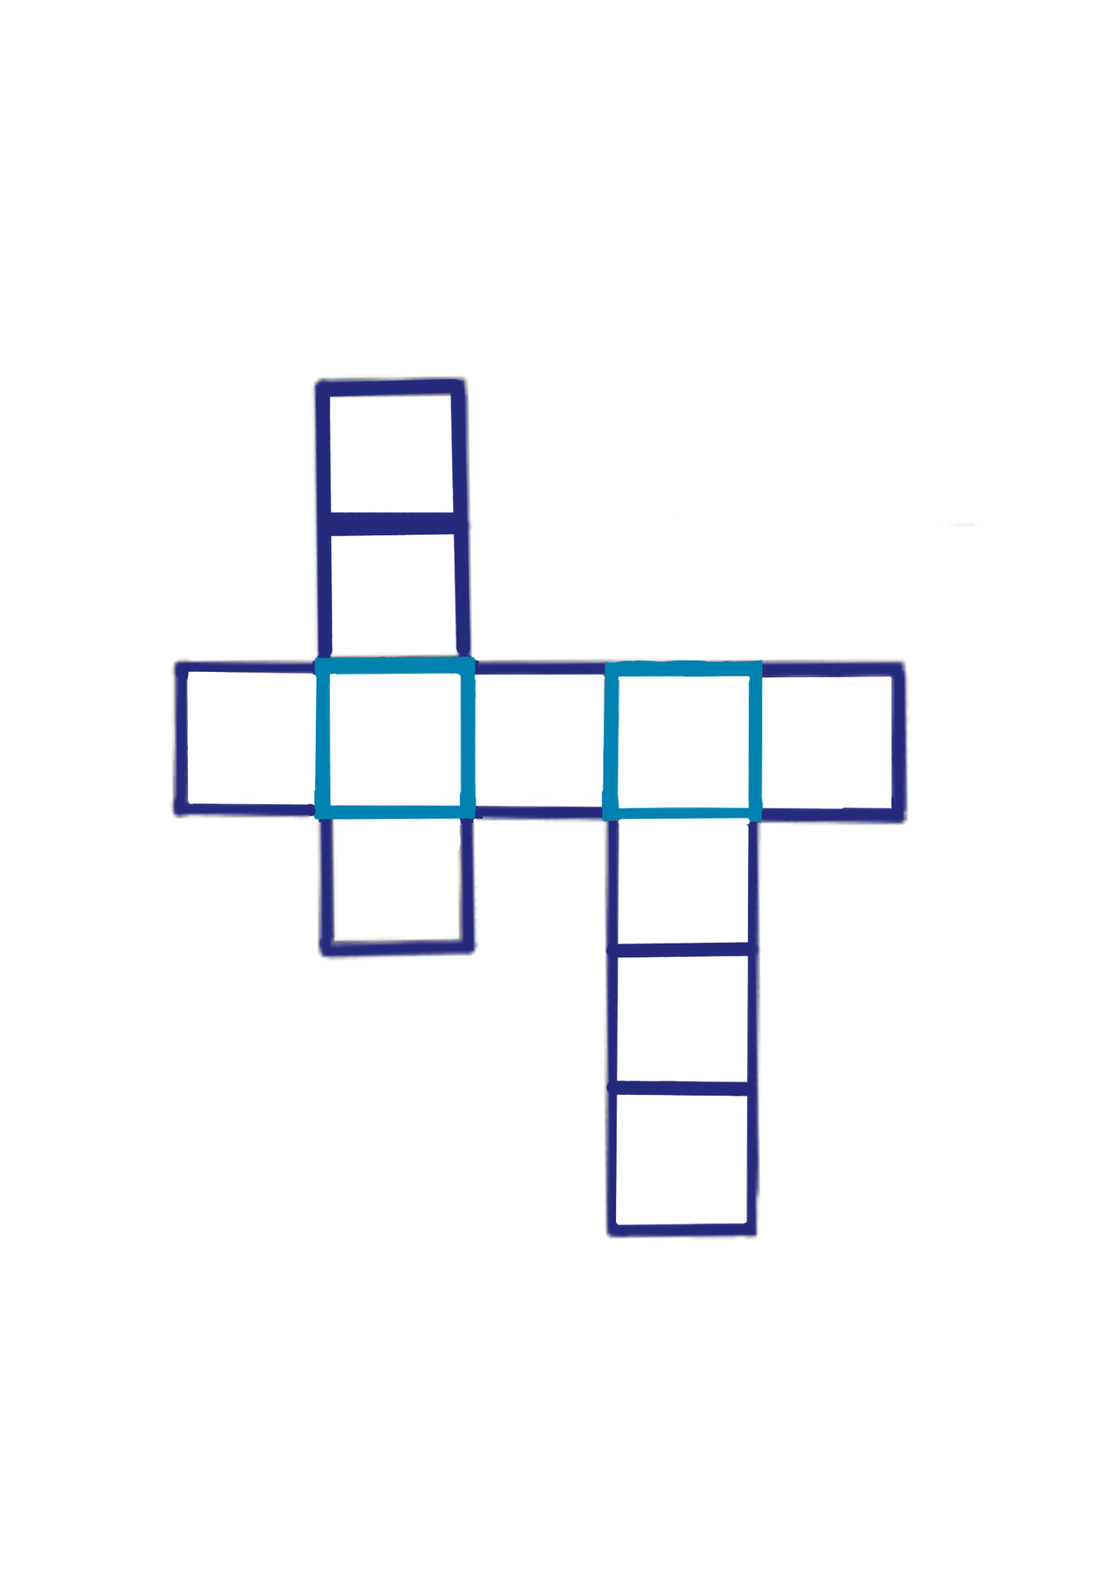
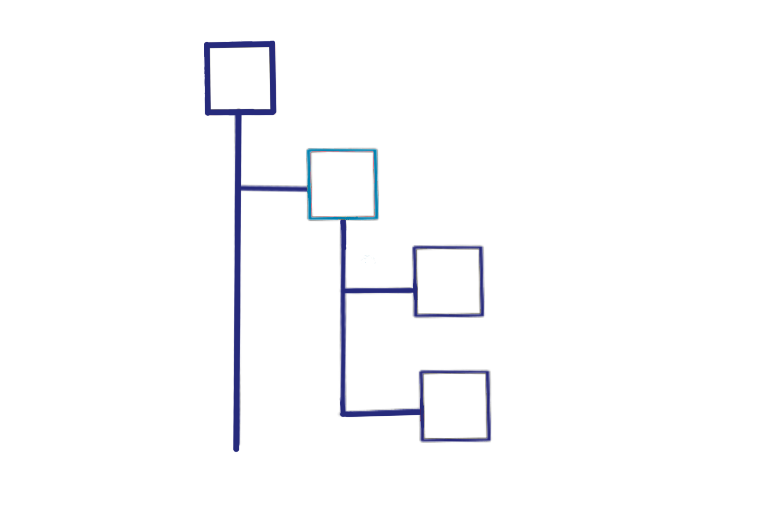
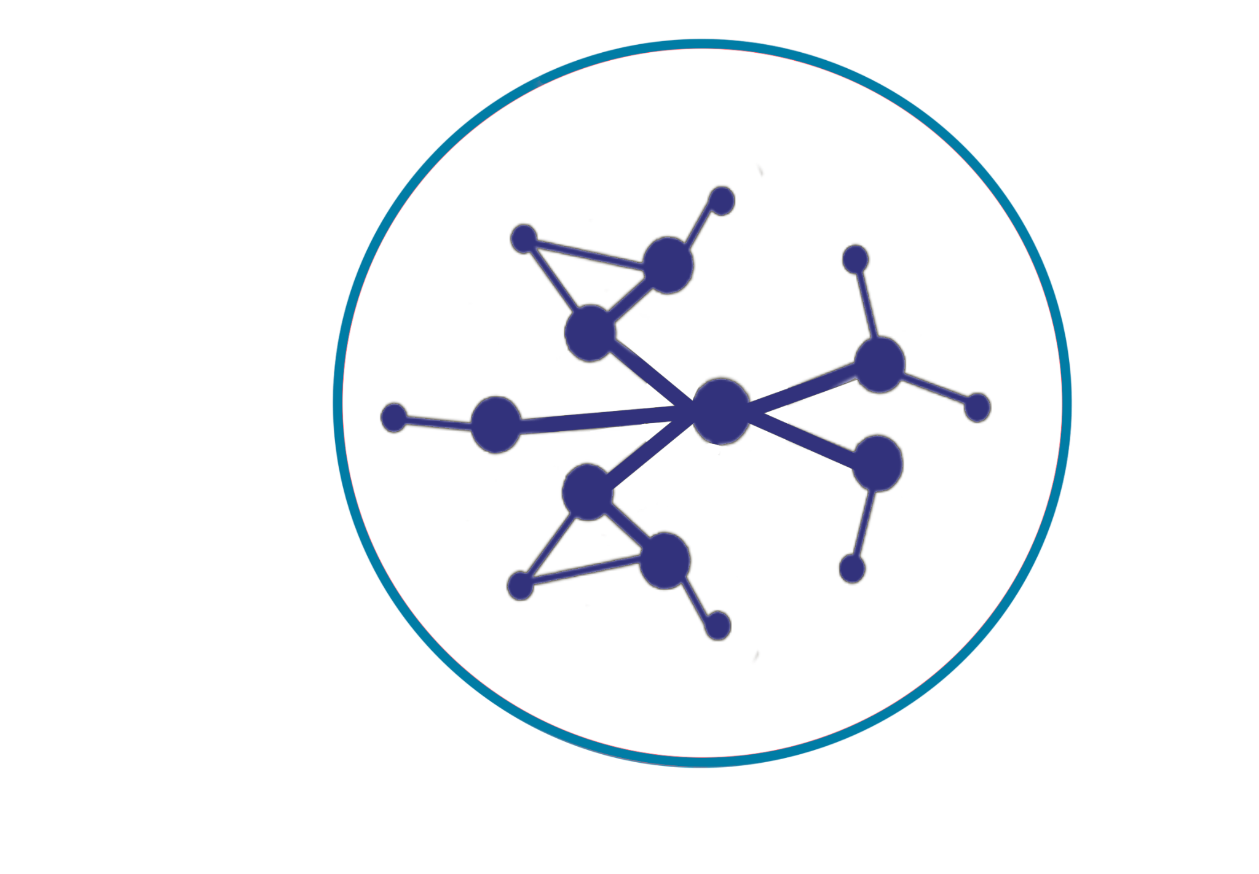
Semantic Governance Scope
Controlled Vocabularies
Taxonomies
Ontologies
Closed list of terms, preferred labels, alternate labels, related terms
Hierarchical structures of broader 2 narrower terms, and lists of related terms
Multi-faceted graph of terms (classes) connected using semantic triples (subject, predicate, object) using the RDF standard
Graphs can connect to other graphs forming a knowledge fabric across business domains.
Each graph is built (modeled) using Process as the centerpiece

Slide 8
Semantic Governance: Target Outcomes
Trusted BI & AI
Smarter, More Reliable AI & Analytics
Business Literacy
A Single Source of Truth for Business Language
Meaning at Scale
Future-Proof, Standards-Based Knowledge
Improved Decision Making
More Informed Decisions, Faster
Knowledge Preservation
Living Business Knowledge That Evolves With Us
Align Business with Technology
One Semantic Layer Connecting People and Systems

Slide 9
Reducing ambiguity, while delivering meaning at scale using a lightweight scaffold across infrastructure of systems, content & metadata.
Solution
Approach, Architecture, Artifacts

Slide 10
Semantic Governance: Impact
Key Outcomes:
The operating model is a strategic shift from extending data management, profiling and enrichment to a disciplined approach combining knowledge & systems engineering.
It's built on foundational principles like a "Top-Down Knowledge Fabric" using taxonomies and ontologies, a "Federated and Process-Centric Design" for modular knowledge graphs, "AI-Driven Automation and Emergence" for validation and enrichment, and "Continuous Improvement and Learning."
The conceptual architecture is broken down into four stages: Inbound (ingestion), Infrastructure (technology foundation), Processing (enrichment), and Outbound (consumption).

Slide 11
Enabling the Knowledge Fabric
Data Fabric
Focus on infrastructure enabling integration, access, and orchestration of data across diverse systems, formats, and locations in a unified, scalable way.
Ensure that data is accessible, governed, and available to support operational and analytical use cases.
Typically includes ETL/ELT tools, data lakes, data warehouses, APIs, and governance frameworks
Knowledge Fabric
Focus on context, meaning, and intelligence from integrated data.
Extends the data fabric emphasizing the semantic layer by dynamically enriching data with context, relationships, and meaning using ontologies, knowledge graphs, and AI-driven reasoning.
Derives insights, enhances decision-making, and creates a shared understanding across an organization by connecting and contextualizing data.
Complimentary

Slide 12
Implementation

Slide 13
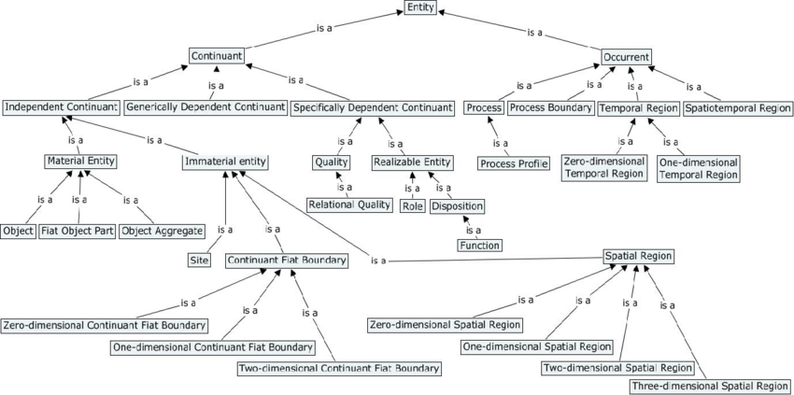
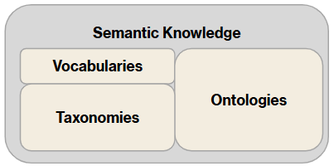
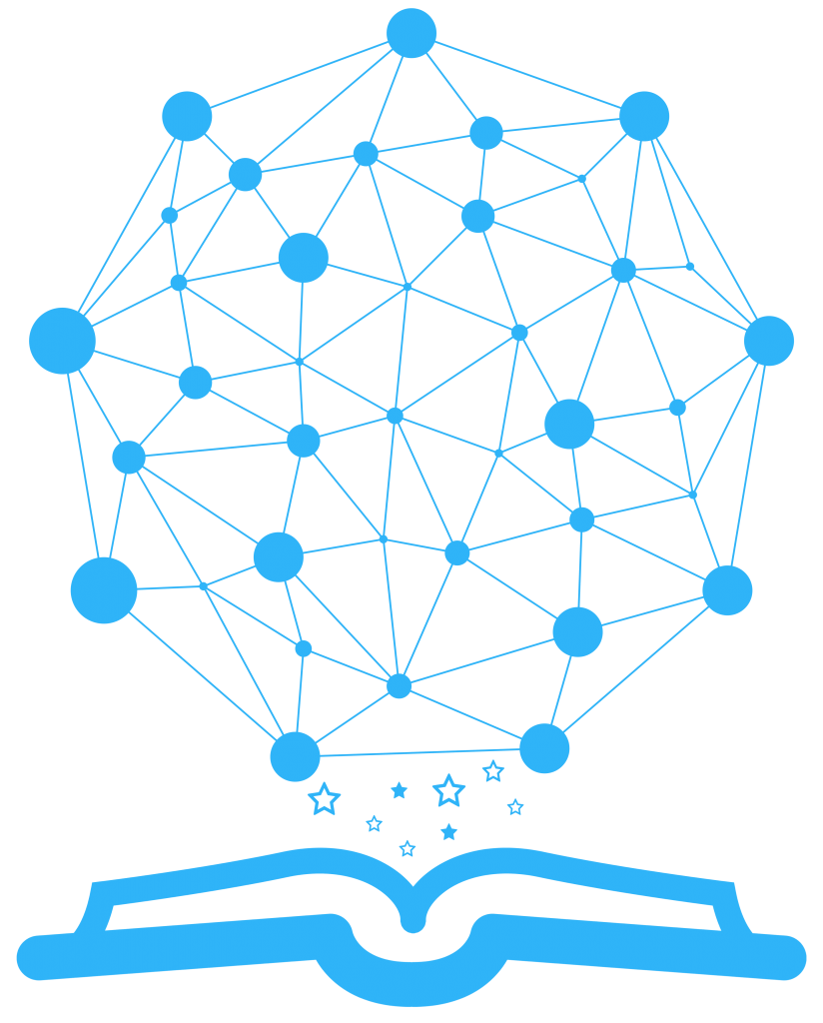
Semantic Governance: (Top-Down View)
Upper Ontology
Base Classes
Relations
Properties
Domain-Specific Ontologies
Unifying Ontology
Learning
Core Domain
Unifying Ontology (DNA) is used to build all Domain-Specific Ontologies
Each Domain-Specific Ontology has their own unique set of Voc, Tax, and Ontology elements

Slide 14
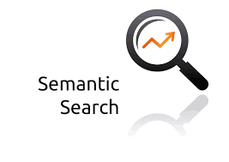


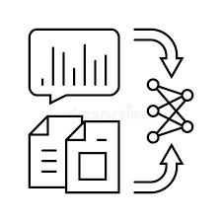
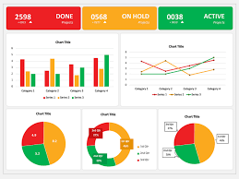
Semantic Governance (Mapping Structure)
AI Framework
Domain-Specific Ontologies
LLM 1
LLM 2
LLM 3
Modeling Environment
Schema Mapping Ontologies
Schema Ontologies
Ontology
Ontology
Ontology
Ontology
Top-Down Ontologies are mapped to Bottom Up Ontologies
Ontology
Ontology
Rag-Based Learning
AI Training Dashboard

Slide 15
Semantic Governance (Service Management)
Service Delivery Model
INBOUND
PROCESSING
OUTBOUND
Sourcing
Ingestion
Scheduling
Mapping at Scale
  Knowledge to Digital Assets (Vertically)
  Knowledge to 3rd Party (Horizontally)
Training & Learning
Extending Knowledge
  Manually
  Automated
Publishing
Subscription
Service Improvement Model
DEMAND
DEFINE
DESIGN
DEVELOP
DELIVER
Customer Requests
Service Gaps
Capability Roadmap
Knowledge Engineering
Systems Engineering
Information Architecture
W3C, OMG Semantic Governance
ISO 11179, OMG Meta-Object Facility
Service Operating Model
Service Level Management
Monitoring & Measurement
Continuous Improvement
Continuous Learning
Business Continuity
Issue / Investigation Management
Escalation/ Communications Management
Problem / Resolution Management
Portfolio Management
Customer Relationship Mgmt.
Value / Outcome Reporting
Value Gap Assessment

Slide 16
Impact
max growth
Future Opportunities

Slide 17
Semantic Governance: (Integration Opportunities)
Compliance Management
Knowledge Engineering
Content
Management
Semantic Governance
Metadata Management
Trad AI
Analysis & Decision Making
Analytic Insights
Knowledge Graphs
Process Management
Data
Management
Gen AI
Generate, Synthesize, Dynamic Problem Solving
Agentic AI
Autonomy, Goal-Oriented Behavior, Reasoning

Slide 18
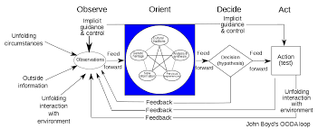
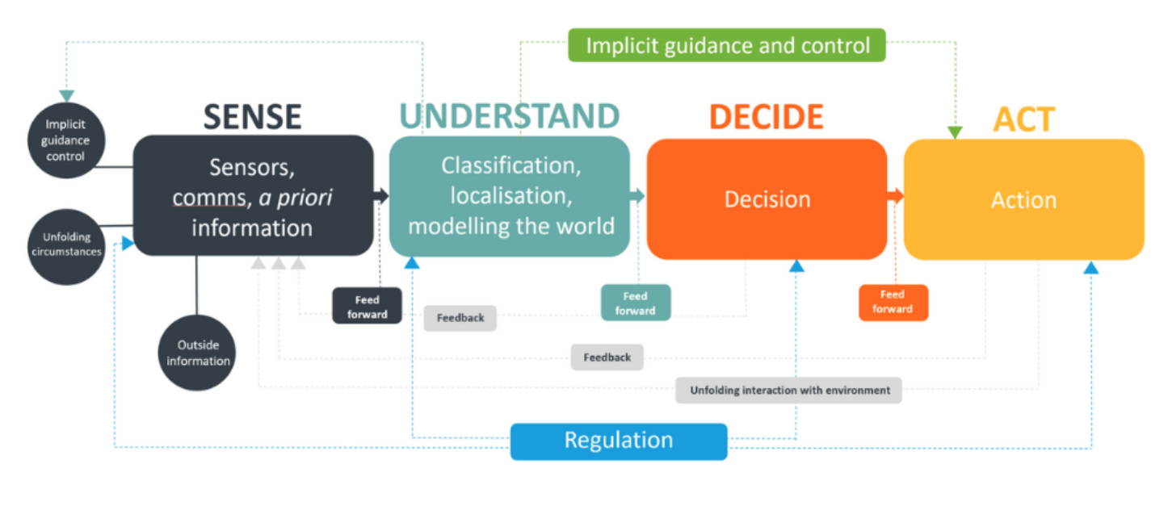
Semantic Governance: (From OODA to SUDA)
The OODA loop was introduced in the 1950’s by military strategist, US Air Force Colonel John Boyd to help pilots make faster and better decisions.
The SUDA model was developed more recently to improve decision making for AI by leveraging biomimicry to simulate the feedback & learning.
SUDA builds on OODA by introducing models of knowledge and mapping data (content & context) to concepts at scale under a semantic governance framework of continuous learning and adaptation, which embraces complexity.
‹#›

Slide 19
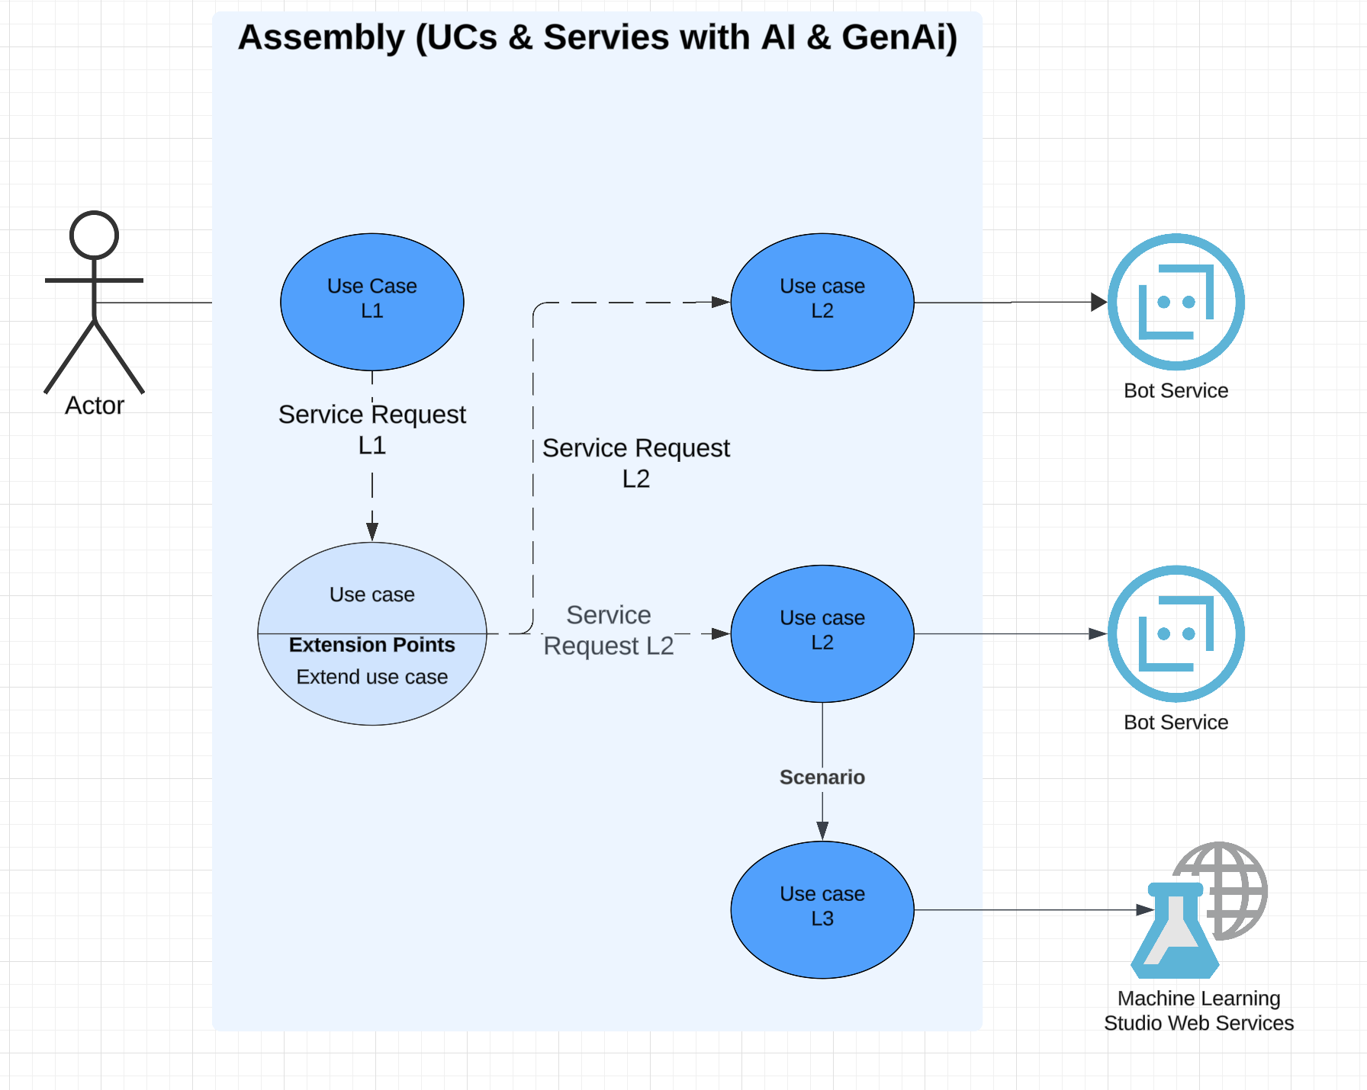
Semantic Governance: Mapping of concerns: Personas, Use Cases, Agents…
Need to understand granularity & cardinality in the larger scheme:
Actor (= Persona)
  1:M Use Case (taxa?)
    1:M Intents
      1:M Services
Service
  Integration
  Agent (Bi)
  Agent (AI)
  Agent (DI)
Service granularity (taxa)
Agent granularity (taxa?)
We may need to build registries covering:
Use Cases
Services
Agents
Models
Metrics
Decisions
Need a scalable way to track usage (embed) and/or consumption (service requests). Former is Design Time, Latter is Run Time

Slide 20
Semantic Governance: Lifecycle Considerations - Blending of Design Time & Run Time
As we step into Agent-Based design, we may want to align on some target state capabilities so we reduce the costs for refactoring agents. Much of our solution design is still macro level focus as design is driven by Use Cases, which are also macro level and cross-domain concerns.
Do we need to start thinking about ….
== > Lifecycle Design for Build & Assembly (static, then dynamic)

Slide 21
Semantic Governance: Lifecycle Considerations - DFMA as a Discipline
DFMA = Design for Manufacturing and Assembly (introduced to support Industry 4.0+)
This has been around for a number of years and is gaining momentum as companies begin exploring agent based design.
Core Principles:
Make multi functioned parts
Minimize parts
Simplify/optimize manufacturing process.
Eliminate interfaces
Use standard components
Ease in handling
Minimize reorientation during machining or assembly
Encourages concurrent engineering
Take advantage of modular assembly
DFMA is the combination of DFM (mfg) and DFA (assembly)
Focus on simplifying product with manufacturing ease and efficient assembly.
Minimum Time (Shorter time to market)
Lower cost
Increased reliability

Slide 22
Semantic Governance: Lifecycle Considerations - Learning in Complex Systems
DFA and Emergent Behavior Theory maps very nicely into our goals with AI, BI, SI (semantic), and DI (decision):
Collective Learning (top level domain)
Collaborative Learning (inter-domain)
Organized Learning (intra-domain = bottom up)
Organizational Learning (macro)
Some of the challenges we are facing with complex systems involve computational resource optimization, linguistic translation, and algorithmic complexity when we REACT using our solution designs

Slide 23
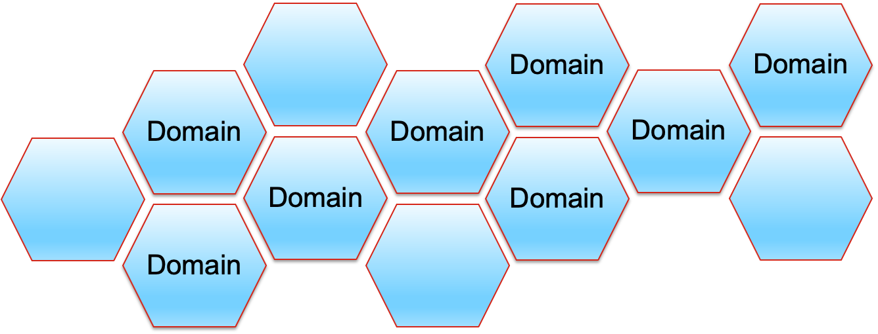
Semantic Governance: (Enabling Emergent Intelligence & Behaviors)
Agent: Reference Model
Goals
Convergence of 4 separate disciplines:
BI (analytic)
AI (probabilistic)
SI (deterministic)
DI (decisions)
Memory
Agent
Sense*
& Understand
Reason
Plan
Decide
LLM
SLM
Learn*
SLM
SLM
Coordinate
Act

Slide 24
The Journey Continues…
Thank You

